Slide 1
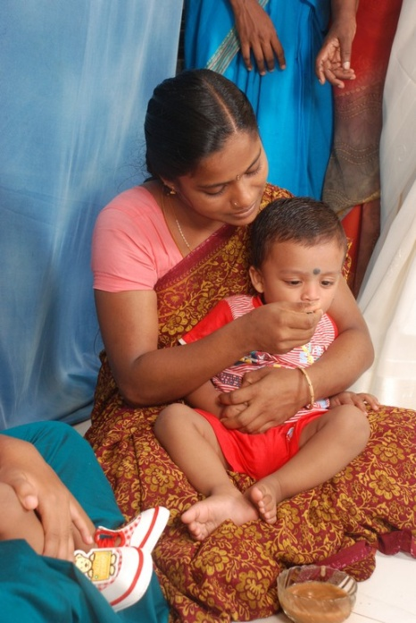
BEST PRACTICES IN ICDS COMBATING MALNUTRITION

Slide 2
What Do We Mean by Best Practice ?
Best Practice may be defined as a practice with various special characteristics such as;
Innovativeness
Ability to lead an actual change
Having an impact on policy environment
Replicability and sustainability (ability to self-support)
Contribution to increase the efficiency of the initiative (that is, optimum use of resources to enhance outputs and outcomes) and
Contribution to increase the effectiveness (that is, its contribution to the achievement of the set objectives of the scheme in which the practice occurs)
Source- Social Sector Service Delivery- Good Practices Resource Book developed by Planning Commission in 2009

Slide 3
Classification of Best Practices in ICDS
Practices for Strengthening Service Delivery
Preparation and Distribution of Supplementary Nutrition
Implementation of Non Formal Pre Schooling
Nutrition and Health Education
Practices for Strengthening Human Resource Management
Event Based Good Practices
Campaign Based Good Practices
Good Practices Concerning Integrated Approaches
Dular Strategy
Positive Deviance Approach

Slide 4
Positive Deviance- Community Based Nutrition Rehabilitation Model
Location - West Bengal and Odisha
Pilot Phase - 2001-2004
Initiation - Pilot Project in Murshidabad, Puralia, Dakhin Dimajpur and North 24 Parganas of WB.
Focus - Reducing Malnutrition among Children > 3 years
Aim - Behavioural Change Through Participatory Learning and Community Mobilization

Slide 5
Assumption –
There are untapped resources inherent in each community and these may enable villagers to use existing solutions to address complex problems.
Approach -
Collective learning to identify positive nutrition practices by individual families and which can be adapted by the larger community.
Sharing of Best Feeding Practices that Exists within the Community

Slide 6
Community members contribute eggs and vegetables. Mothers learn how to cook more nutritious meals, which in turn creates community ownership in the management of child malnutrition.

Slide 7
Partners
UNICEF, West Bengal
ICDS Directorate
Child In Need institution (CINI)
Christian Children’s Fund (CCF)
Shibpur People’s Care organisation (SPCO)
Association of Social Health and Advancement (ASHA)

Slide 8
Advantages
Bottom Up Approach
Effective Tool of Convergence
Capacity Building of AWWs
Changing Perception of the Community – We Can Certainly Do It
Impact Assessment
A steady reduction in the moderate and severe level of malnutrition was noted across four districts
Acceptance of desirable behavioral practices within the community
Replication -
Implementation in Orissa and in Other Districts of WB

Slide 9
Dular Strategy
Location –
Four Districts each in Bihar and Jharkhand
Period –
Pilot Project in 2001
Aim –
To capitalize and develop community resources at the grassroots level.
To combat malnutrition, infant mortality and poor maternal health
Establishing a community-based tracking system of the health status of women and of children 0 to 36 months of age by neighbourhood-based local resource persons (LRPs).

Slide 10
Strategy of getting the people to be responsible for their own welfare.
Community members, act as volunteers and “peer educators” within their locality (LRPs)
Bringing a positive change in their own socio-economic environment.

Slide 11
Anganwadi worker in every targeted village teams up with a small group of local resource people who are then given a basic training in nutrition, childcare and hygiene.
Once trained, the team visits pregnant women and mothers of newborns in their homes to educate them about safe delivery, breastfeeding, immunisation, and other essential care practices during pregnancy and early childhood.
Since the team is made up of local people from the community, parents respond positively.

Slide 12
Impact Assessment –
Successfully improved infant feeding behaviour and reduced malnutrition.
Differences were found between Dular and non-Dular villages in all major outcomes. Particularly noteworthy is that young children in Dular areas had a 45% lower prevalence of severe malnutrition and were four times more likely to receive colostrum than those in non-Dular villages.
Cost-effective instrument for reducing child malnutrition

Slide 13
Number of women receiving antenatal check-ups increased from 49 per cent to 82 per cent during the first four years of the project.
A comparison between Dular and non-Dular districts indicates that the percentage of mothers feeding colostrum to their children – known to be extremely vital for children – had increased from 22 per cent to 82 per cent in the project districts
Evaluation by Tufts University

Slide 14
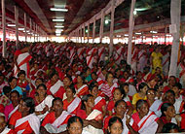
Extension of the Project in Jharkhand to another three Districts after its success in the field.
Dular will now reach 3 million children and women in the state – nearly double the existing outreach number.
14.45 Crore for Dular Strategy ( 2008-09)

Slide 15
Annaprashan Abhiyan
Location : Madhya Pradesh , Rajasthan and Andhra Pradesh (Balintadarshanam)
Objectives : To generate awareness on Complementary feeding in the
Community
About the Practice
Annaprashan Ceremony is generally being held in Community Halls and local schools
The children after six months of age are being introduced to Complementary Feeding in a combination of tradition, festivity and a joyous celebration.
Those children, who attend the ceremony are being given a katori and a spoon.
Rallies, Baby shows and cultural shows are also being organised to create awareness on complementary feeding in the community.
Outcome : The Annaprashan Abhiyan is receiving wholesome participation of women, adolescent girls and children.

Slide 16
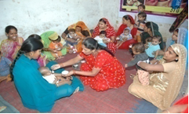
Mangal Diwas
Location : Madhya Pradesh
Period : Since 2007 onwards
About the Practice :
Celebration of first Tuesday of the month as Godbharai ceremony of Pregnant Women.
Distribution of Iron and Folic Acid Tablets.
Providing NHED to Pregnant Women along with their family members on complete care during pregnancy, ante natal care , safe motherhood, institutional deliveries, significance of balanced diet, intake of seasonal fruits and vegetables and information on other nutritious meals.
Release of monthly magazine Anganwadi Samacharika covering all important messages.

Slide 17
Janam Diwas
Location : Madhya Pradesh
Periodicity : 3rd Tuesday of every month
Objective : To celebrate birth-day of all children who were born during the month
About the Practice :
Weight of the children are taken and recorded on a register.
Immunization status of children is checked
Children who have not completed primary vaccination (BCG, three doses of DPT and Polio, and Measles) are referred to NHD camps for scheduled immunization doses.
Children whose birth day falls during the month are offered birthday gifts

Slide 18
Celebration of Nutrition and Health Day
Location : Andhra Pradesh
About the Practice :
Nutrition and Health Day is being organised every month in each AWC on a fixed day and at fixed time so as to ensure the coverage of all vulnerable pregnant and lactating women and children less than three years.
On this day, besides providing periodic ICDS services , Kalajathas /Street Plays, Puppet shows, Films, Songs, Drama etc. are also being organised on specific themes or topics covering various aspects of nutrition, feeding methods, child growth etc.
Advertisements through pillar boards, and through set of charts on pregnancy care, exclusive breast feeding, weaning foods, immunisation etc. are also being taken up.
Outcome :
The practice has improved the quality service delivery as well as coverage of beneficiaries.
Improvement in behaviour change and in nutritional status of beneficiaries has also been observed.

Slide 19
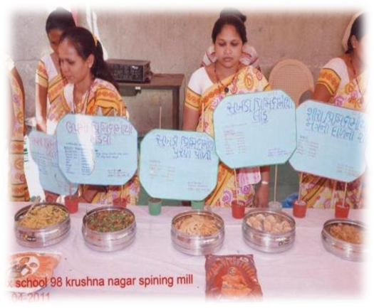
Rasoi Show in Gujarat& Ration Card to SNP Beneficiaries in Andhra Pradesh
Rasoi Show (Gujarat)
Objectives : To orient the ICDS beneficiaries about the nutritional benefits of
Pre-mix packets being given as THR and various types of recipes
Periodicity : On every 2nd Thursday of the month.
About the Practice : Showcase preparation of various nutritious recipes using the resources available locally.
Ration card to SNP Beneficiaries (Andhra Pradesh)
About the Practice : Making Entry of Data Concerning SN in Ration Cards of ICDS Beneficiaries
Out Come :The practice ensures transparency and accountability in the system.

Slide 20
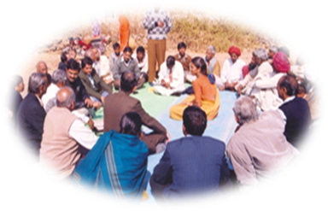
Mobilising Community Participation through Mahila Samiti
Location : Menjanahalli, a small hamlet in Rural Karnataka
Practice Partners : Joint initiative by –
Gram Vikas, a local NGO
ICDS and the
Women’s group Mahila Samiti
About the Practice
The children attending the AWC are getting the three meals (morning, lunch and evening) a day.
Gram Vikas is funding the morning meal, ICDS provides the lunch and Mahila Samiti gives the evening meal.

Slide 21
Baby Friendly Community Health Initiative
Location ; Lalitpur in UP
Duration : 2006 till 2012
About the Practice :
Establishment of Mother Support Group comprising
AWW,AWH, ASHA and Traditional Birth Attendant to
improve IYCF Practices
Training of Mothers Support Group
Outcome :
% increase in Breast Feeding within one hour from 10.6% in 2006 to 62 % in 2012.
% increase in Complementary Feeding from 6.6% in 2006 to 60% in 2012

Slide 22
Social Mapping through Mother Support Group
Location : Tamil Nadu
Duration : Since May 2004
Periodicity : Once in every month/fortnight.
About the Practice :
Conducting social mapping at a common place by all members of the social institutions like SHGs, Working Women Group (WWG), Adolescent Girls Group (AGG), local teachers, PRIs and any other groups functioning in the village.
Visit of mother support group to the target families and interaction with them about the usage of MCP Card and growth monitoring activities.
A circle is drawn with 9-10 divisions. Each division in the spider map denotes specific family practice e,g. maternal diet, early initiation of breast feeding, exclusive breast feeding up to six months, complementary feeding at the right time, quality, quantity and frequency of complementary feeding, feeding during illness, use of iodized salt, hand washing etc.
MSG draws this map whenever they meet and discuss and share to find out where they are and where they should move.
Outcome : A lot of awareness has been generated among the community on various issues related with ICDS.

Slide 23
Providing Gas Chullahas Connections , and Idli Cooker from Flexi Funds in (AP, Haryana and Gujarat) & SANJHA CHULLA IN MADHYA PRADESH
Providing Gas Chullahas Connections and Idli Cooker from Flexi Funds in Andshra Pradesh , Haryana & Gujarat)
Objectives
In order to provide freshly prepared supplementary nutrition every day at the AWC and
in order to save the AWW and AWH from harmful exposure of the smoke from ‘chulha’
Sanjha Chulla in Madhya Pradesh
About the Practice
ICDS in convergence with mid day meal scheme implements joint supplementary feeding programme called “Sanjha Chulha”
Two Hot Cooked meals i.e. morning snacks and lunch is prepared with the help of local SHGs and served at AWCs.
This allows AWWs and AWHs to spend more time with children for pre-school education activities, home visits and counselling for under threes.

Slide 24
Establishment of Community Resource Centre
Location : Kerala
Objectives Providing all type of Information required to run the
Mother’s Club and Adolescent Club etc.
About the Practice :
Community Resource Centers serve as multi level single window service centre
Establishment of CRC in 567 AWCs located across the States.
These centres have been equipped with :-
Computers and Pre-School Education CDs and reading and library facilities for local woman and adolescent girls.

Slide 25
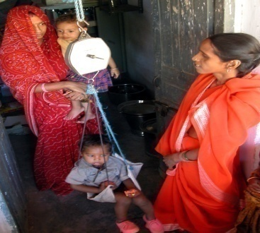
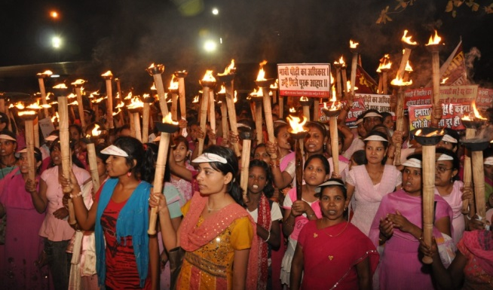
Cluster community Volunteers in Madhya Pradesh & Community March against Malnutrition in Chhattisgarh
Cluster Community Volunteers in Madhya Pradesh
About the Practice :
In 15 high burden districts, Community involvement and ownership has been ensured by selecting one honorary community volunteer for each pairs of 25-30 households.
These volunteers not only provide counselling on different health and nutrition aspects but also provide supportive supervision to AWW as well.
Community March against Malnutrition in Chhattisgarh
About the Practice :
In order to educate the community and the family about
various preventive aspects of malnutrition, Community March
is being organised across the State

Slide 26
KITCHEN GARDEN
Location : Assam & Tripura
Objective : To promote nutrition security food diversity to fulfill the additional nutritional requirements of adolescence age.
About the Practice :
Adolescent girl clubs have been formed and trained to develop and maintain kitchen gardens
Proper cooking practices for preserving nutrients through cooking demonstration and recipes contest
Seedlings of species like Green-Banana, Papaya, Drumstick & Amla are raised under decentralized nursery
Outcome :
Development of Kitchen Gardens in AWCs and Crèches
822 kitchen gardens have been completed

Slide 27
Use of ICT in SN Monitoring
Location : Sajhapur District of MP
Objective : To provide the real time data about SN
About the Practice : Sending SMS by AWW through Toll free numbers

Slide 28
Akshaya Patram
Location : Tamil Nadu
About the Practice :
Mothers are encouraged to send their children with one vegetable each to the AWC and drop it in the common container(Akshaya Patram) which adds nutritional value to the cooked supplementary food.
Training of AWWs in the Montessori way of education in phased manner.
Modernization of AWCs by providing gas stoves, pressure cookers, storage bins, cooking vessels, etc.

Slide 29
Mother Support Groups in Andhra Pradesh & BAL Vikas Samiti in Karnataka
Mother Support Groups in Andhra Pradesh
About the Practice :
Establishment of Mother Support Groups in the catchment area of each AWC.
These Mother Support Group (MSG) collectively sensitise the ICDS beneficiaries about the importance of Infant and Young Child Feeding (IYCF) practices mainly on breast milk within one hour.
Bal Vikas Samiti in Karnataka
About the Practice :
Constitution of Bal Vikas Samithis in each AWC to monitor the activities of the centre.
The President /Vice President of Gram Panchayat acts as chairman of the committee.
The other members of the committee include Headmaster of primary school, four lady members of SHG group, four mothers of children attending AWC, ASHA Worker.
The Anganwadi Worker acts as member secretary of the committee.

Slide 30
Mata Yashoda Award for Best AWW and AWH IN Gujarat & Best Mother Award in Haryana
Mata Yashoda Award in Gujarat
Period : 2007-08
Objectives :
To Motivate AWW and AWH
Recognise the exemplary work being performed by AWWs and AWHs.
About the Practice
This State level award consist of cash incentive of Rs. 51,000/- and Rs. 31,000/ respectively to AWW and AWH and Citation.
Best Mother Award in Haryana
Objective : To encourage mothers to proper rearing of their children.
About the Practice : 3 best mothers having at least one girl child are awarded with monetary benefits

Slide 31
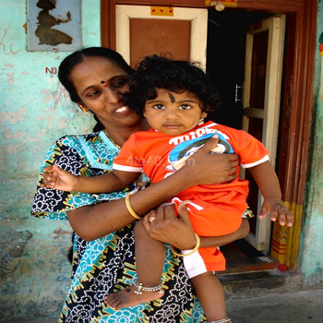
Combat Malnutrition and Under-5 Mortality
Location : Assam
Objectives :
Growth monitoring of each child and linking every child with the service provider
Automatic generation of field performance through WHO-Anthro with Individual child tracking & monitoring
About the Practice :
Unique ID number is given to each child to avoid duplicacy which includes code for CDPO, Supervisor, AWW and child to link child with the service provider.
IEC booklet with the information about nutritional status of child, its related problems and how to improve the nutritional status of the child at family level is developed.
Child photograph with mother is affixed to bring about a sense of involvement of the mother on IEC booklet

Slide 32
Contd…
Outcome :
Simple and systematic child registration system in place
Correct plotting of weight of 90% children in the district using WHO Growth Chart using WHO-Anthro 2011 package
Regular review of performance at all levels from AWC to district level : increased the service delivery quality

Slide 33
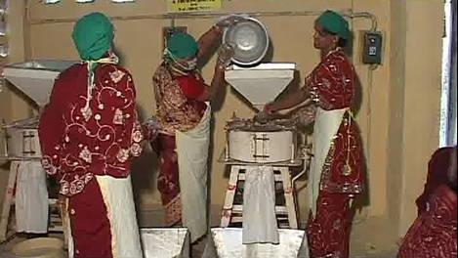
Decentralization of SNP through Community engagement
Location : Odisha
Objective : To ensure the good quality of food
About the Practice :
There is an involvement of local communities Monthly monitoring at GP level ensured Jaanch Committee and Mother’s Committees (involvement of community) are set.
Food items stored only for one week, purchase of certified oil and soya and dal, eggs and rice quality is checked.
Egg is given to Pre-School children and THR beneficiaries.
Outcome : Capacity building of AWWs and AWHs is done.

Slide 34
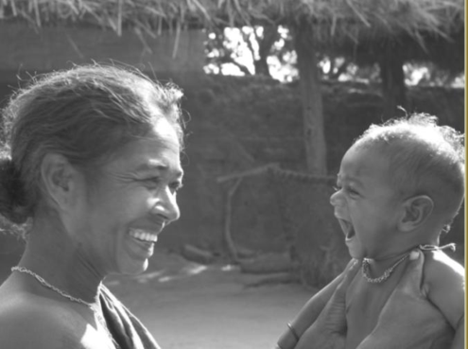
Mamta
Location : Odisha
Objectives :
To provide partial wage loss compensation for pregnant and nursing mothers.
To increase utilization of maternal and child health services.
To improve mother and child care practices, especially exclusive breastfeeding and complementary feeding of infants.
About the Practice :
Anganwadi Workers plays pivotal role in the scheme by doing timely registration of pregnant women at AWCs.
Facilitate opening of Bank account of beneficiaries.
The AWW and AWH given incentives of Rs 200 and 100 by enrolling per beneficiaries.
Outcome : Monitoring and supervision done at all centers.

Slide 35
Community contribution for carriage of SNP
Location : Nagaland
About the Practice :
The carriage charges of SNP from the Projects to the Aganwadi centers are borne by the community through the fund given from the Village development Board.
The community contributes the firewood for cooking the Hot cook meal in the AWCs and also provide water supply to the Centres.

Slide 36
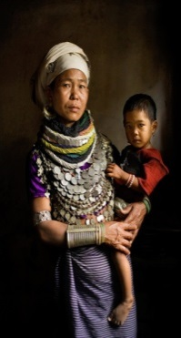
Job to the Parents of Malnourished Children
Location : Tripura
Objectives : Extra income is provided to the families of malnourished children to improve the
nutritional condition
About the Practice :
CDPOs will send the list of malnourished children to the BDOs on monthly basis
The BDOs will provide additional employment and income generation avenues to such families under MGNREGA/PDF.
The families get the necessary support and provide necessary nutrition to the malnourished children.

Slide 37
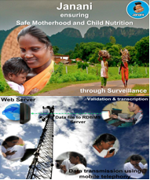
E-Janani for Individual Tracking for Nutritional Status
Location : Tripura
Objective : Ensures safe motherhood and child nutrition through surveillance
About the Practice :
Tracking of all mother and children and bringing focus to those who are at risk
From inception to delivery 110 data fields are collected form a mother over a period of one year.
Data transmission is done by using mobile telephone.
Outcome : Child tracking from birth to five years (Birth, Registration, immunization and Growth monitoring)

Slide 38
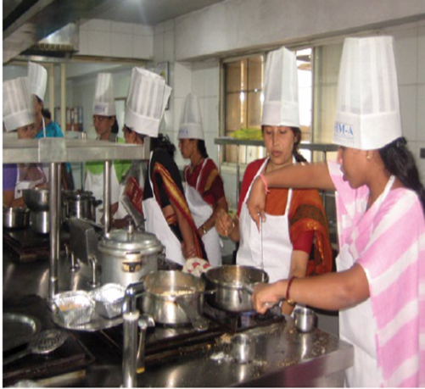
Food Diversification Project to Improve SN Under ICDS
Location : Nandurbar District of Maharashtra
Practice Partners :
Government
Taj Group of Hotels,
Institute of Hostel Management ,(Aurangabad)
NGO(Sriram Ahirrao Memorial Trust).
Objectives :
Making available diverse nutrition recipes using local ingredients within current costs at the AWCs.
Improves quality, hygiene, palatability by enhancing the capacity of SHGs
Promoting good nutritional practices amongst mothers by training them on methods of cooking

Slide 39
Contd…
About the Practice :
A team consisting of a Chef of Taj Group of Hotels and microbiologist cum nutritionist. They surveyed the area, their food habits and locally available foods and developed 36 recipes as per the ICDS norms.
Few more soy-based recipes were also added as recommended by the State Health & Nutrition Mission .
Training kit developed and the training was imparted to trainer’s (Supervisors, CDPOs and some NGOs).
They disseminated this knowledge to about 12,000 AWWs, mother’s committee members & SHG members .
Outcome :
Number of recipes served increased from 2 to 6.
In selected 161 AWCs the number of beneficiaries increased from 1,31,984 to 1,49,174 in the district.
No leftover of food.
Increase in palatability and hygienic handling of food.

Slide 40
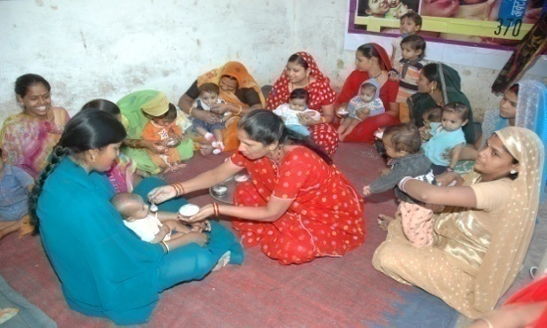
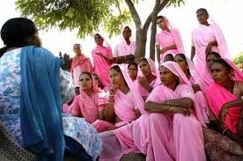
THANK YOU!!

